Slide 1

Presented by
IU South Bend Informatics and Department of Computer and Information Sciences

Slide 2







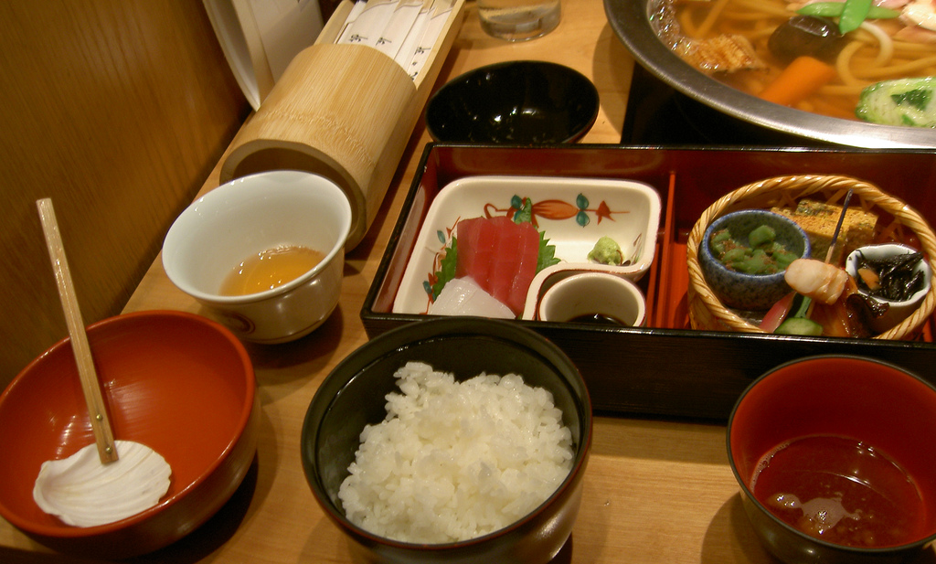

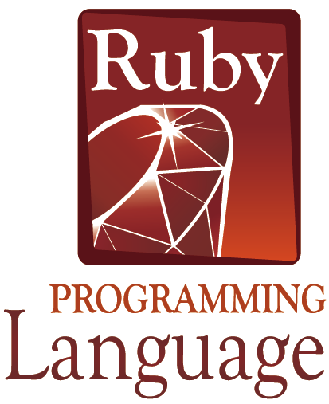





Slide 3

Pure object-oriented design:
All variables are objects within Ruby.
Powerful languages constructs:
Less code needed to solve the problem
Consistent and concise language:
The syntax is easily to learn and master
Enhance the joy of programming:
Allows for the rapid development and testing of reusable code

Slide 4

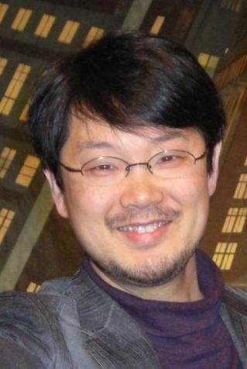

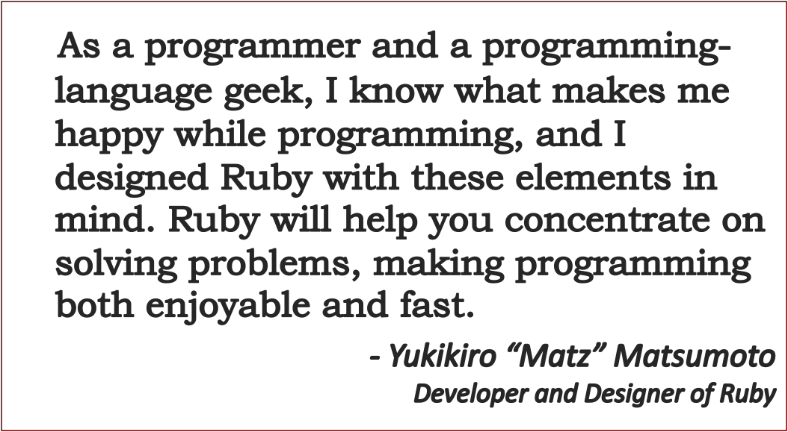

Slide 5

Python
Perl
Lisp
Smalltalk
YARV
Jruby
Rubinius IronRuby Groovy
Ruby

Slide 6

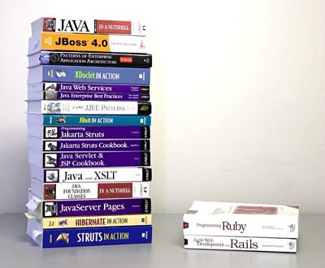
The language is easier to learn than Java or C++
Ruby takes less code to say the same thing.
Software can be developed and tested interactively, or interpreted or compiled from files.
The Ruby user community is actively documenting everything.
English (and Japanese) tutorials and books on Ruby are ubiquitous in stores and on the web.

Slide 7

Four examples
of Ruby programs

Slide 8

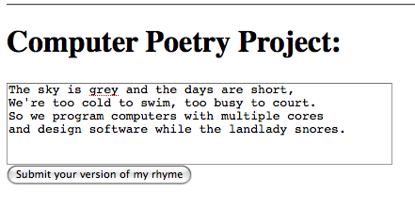
require "cgi”
cgi = CGI.new("html3”)
cgi.out{
cgi.html{
cgi.head{"\n"+
cgi.title{"CPP”}} +
cgi.body{"\n"+
cgi.form("post","add2poem.rb") {"\n"+
cgi.hr +
cgi.h1 { "Computer Community Poetry: " } + "\n"+
cgi.textarea("get_text",50,5) {
File.readlines("mypoem.txt") } + "\n"+
cgi.submit("Submit your version of my rhyme")
} } } }

Slide 9

Ruby
GCC
def fib(n)
if n > 1 then
fib(n-2)+fib(n-1)
else
1
end
end
puts ”N Fib(N)”
1.upto(100) do |x|
puts ”#{x}=#{fib(x)}”
done
#include <stdio.h>
#include <stdlib.h>
int fib(int n)
{ if (n > 1)
{ return(fib(n-2)+fib(n-1)); }
return 1;
}
int main(int argc, char ** argv)
{ puts(“N Fib(N)\n”);
for ( int n = 1; n <= 100; n++)
{ printf(“%d = %d\n”,
n, fib(n));
}
return(0);
}

Slide 10
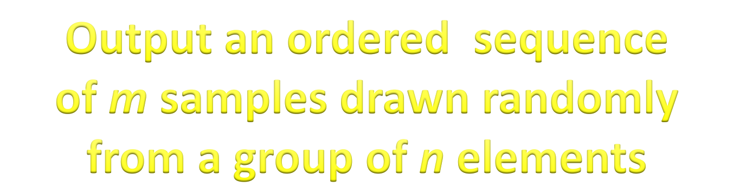
(m, n) = ARGV.map { |s| s.to_i} # get m,n from cmd line
g = 1…m # create the sample pool
s = Array.new # create a sample set
m.times do |i| # add samples to the set
r = rand * g.size # get a random location
s.push(g.at(r)) # transfer to sample set
g.delete_at(r) # remove from sample pool
end
print s.sort.join(‘,’) # print sorted sample set

Slide 11

tally = Hash.new # set up a word tally
File.new(“file.txt”).each do |line| # read file line by line
line.split(/\s/).each do |word| # split line into words
word.gsub(/[\.\,\?\!\’\”]/,’’) # remove punctuation
word.downcase # convert word to lowercase
tally[word] += 1 # update the word tally
end
end
puts “Word\tCount\n” # output the table header
tally.keys.sort.each do |key| # words in alphabetical order
puts “#{key}\t#{tally[key]}\n” # output word and count
end

Slide 12

You are welcome to join this online opportunity to study and experiment with this fascinating programming
language.
For more details, visit the course website at http://mypage.iusb.edu/~rbatzing.

Slide 13

Check with your advisor
about enrolling in the
CSCI A201 Ruby Programming
online course for Spring 2009

